Slide 1
Final report
Project: Designing and developing a software system for toll collection for padma multipurpose bridge
Submitted by:
ALIF AL RAZI ID: 2011358042
Mahir ayaan begh jeet ID: 2013778642
Siam masud ID: 2011057642
CSE327 SEC-7

Slide 2
Introduction:
Padma bridge toll management system has been designed to collect toll from registered and non registered users. To collect toll rapidly registered users can give toll before they start their journey. Registered user can ask for due also. Non registered users give money at the toll plaza. The operators receives money and check all the payment status of users. The supervisors of toll management system supervise the whole procedure.

Slide 3
Use cases: Operator
User will enter the toll plaza.
Operator ask number plate.
There is a specific code in every number plate to identify the vehicle’s class. Operator match with the original view of vehicle.
Operator input the number plate.
System verifies the number plate is registered for Padma bridge payment process.
The system checks the weight of the vehicle.
The operator input the vehicle class for payment.
Operator check the balances and found paid previously.
Operator certified its paid.
Send message of the payment status to the user.
Operator gives a printed receipt to the user.
Operator permit to go.
The barrier opens automatically.

Slide 4
EXTENSIONS
3a. Operator will not permit to go for mismatch of the original view of vehicle.
Operator inform the authority for mismatch.
The user is asked to park the vehicle in a specific place.
Next vehicle is processed to collect toll.
3b. For special case the vehicle will be permitted to be brought under process.
The operator will ask details of the user including name, address, phone, NID.
4a. Show warning for wrong input.
The operator will check the number plate and input it again.
5a. For non-registered user operator ask details of user including name, phone number.
6-7a. Warn operator for inconsistent weight
The user is asked to park the vehicle in a specific place.
Next vehicle is processed to collect toll.

Slide 5
8a. For unpaid status operator get payable amount from the vehicle class.
Operator takes money from user.
Input the amount of money to the process.
The software shows the amount of return.
The operator gives back the return to the user.
8b. Registered user can ask for making due for shortage of money.
Operator will not permit to cross toll plaza if dew of registered user crosses the certain due limit.
The user is asked to park the vehicle in a specific place.
Next vehicle is processed to collect toll.
10a. Operator gives massage manually to the user.
11a. Operator print receipt giving transection id.
13a. Operator opens barrier manually for disfunction opening barrier.

Slide 6
User’s use case:
User enters the Toll plaza.
User opens the Toll Plaza app.
The user signs in by entering vehicle Id and password.
The user scans the generated QR code .
The user completes the payment through the mobile banking systems.
The User leaves the toll plaza after the barrier is lifted.
EXTENSIONS
3a. Shows warning for entering wrong ID and password,
1. The user Enter the correct ID and password
3b. Taps on Forgot password.
Enters vehicle’s number plate and phone number.
User gets a OTP message
User enters the correct otp.
3a) Shows a warning message for entering the wrong OTP.
4. User enters the new password

Slide 7
3c. The user taps on Sign-Up.
The user provides the required information about himself/herself and the vehicle.
The user gets an ID for his vehicle and sets a password.
The user signs in with his vehicle ID and password
4a. Chooses to manually enter the uniquely generated transaction id.
1. Enter the transaction id manually.
5a. shows insufficient balance to complete the transaction
1. The user gives cash money to the operator.
2. The user receives the change.

Slide 8
User case: Supervisor Of Toll Plaza
Supervisor will click on admin button in login interface.
Supervisor Enter Username and Password.
System Grants Access To User
System Shows Supervisor Toll Booths Are Open.
Supervisor Checks Account Balance Of Toll Booths That Are Open.
Supervisor Checks Payments Collected In Cash Of Toll Booths That Are Opens
Supervisor matches the payment deposited in cash with the payment value stored for cash.
Supervisor sets payment in cash successfully done for the specific toll.
Supervisor checks comment made by toll operator.
Supervisor sees no comment made by toll operator.
Supervisor exit the system.

Slide 9
EXTENSIONS
3a. System denies access to Supervisor
System tell the User to renter password and username.
4a. System shows user toll booth that are closed
Supervisor checks traffic flow in bridge
Traffic Is Larger Than Desired Amount Supervisor Opens Extra Toll booths
2a) Traffic Is Smaller Than Desired Amount Supervisor Will Keep The Extra Toll Booths Closed
5a. Supervisor Checks Payments Collected In BKASH Of Toll Booths That Are Opens
Supervisor matches payment in Bkash account with payment value stored for Bkash
Supervisor sets payment successfully done in Bkash for specific toll.
5b. Supervisor Checks Payments Collected In Card Of Toll Booths That Are Opens
Supervisor matches balance in bank account with payment value stored for card payment
Supervisor sets payment successfully done in card payment for specific toll.
9a. Supervisor find comment made by toll operator
Supervisor acts upon accordingly to comment made by user

Slide 10
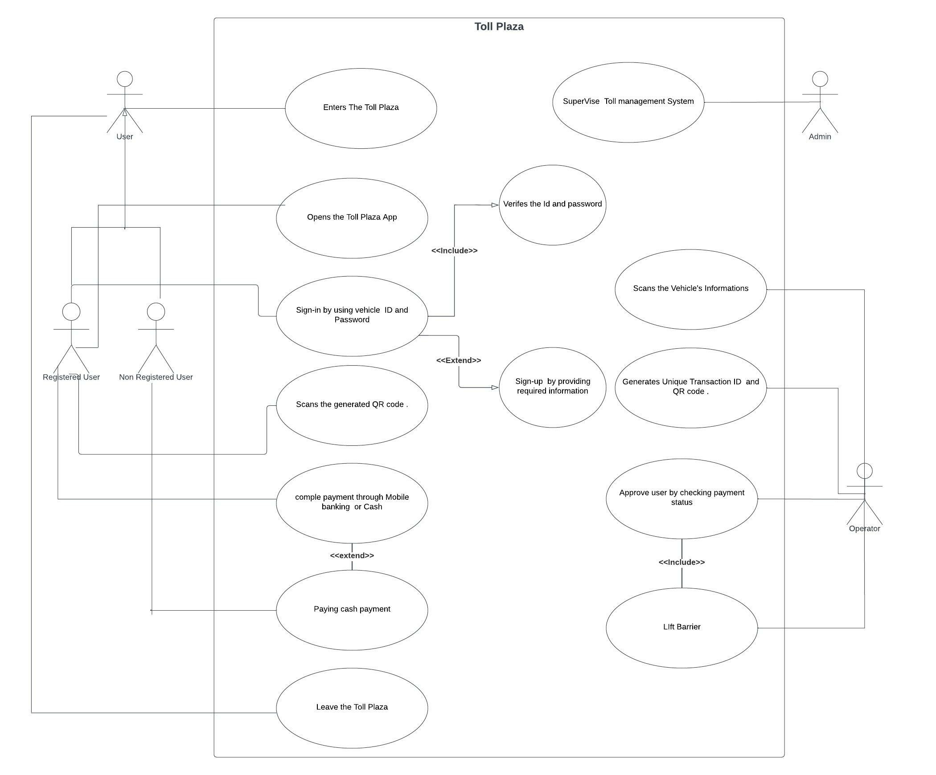
Use case diagram

Slide 11
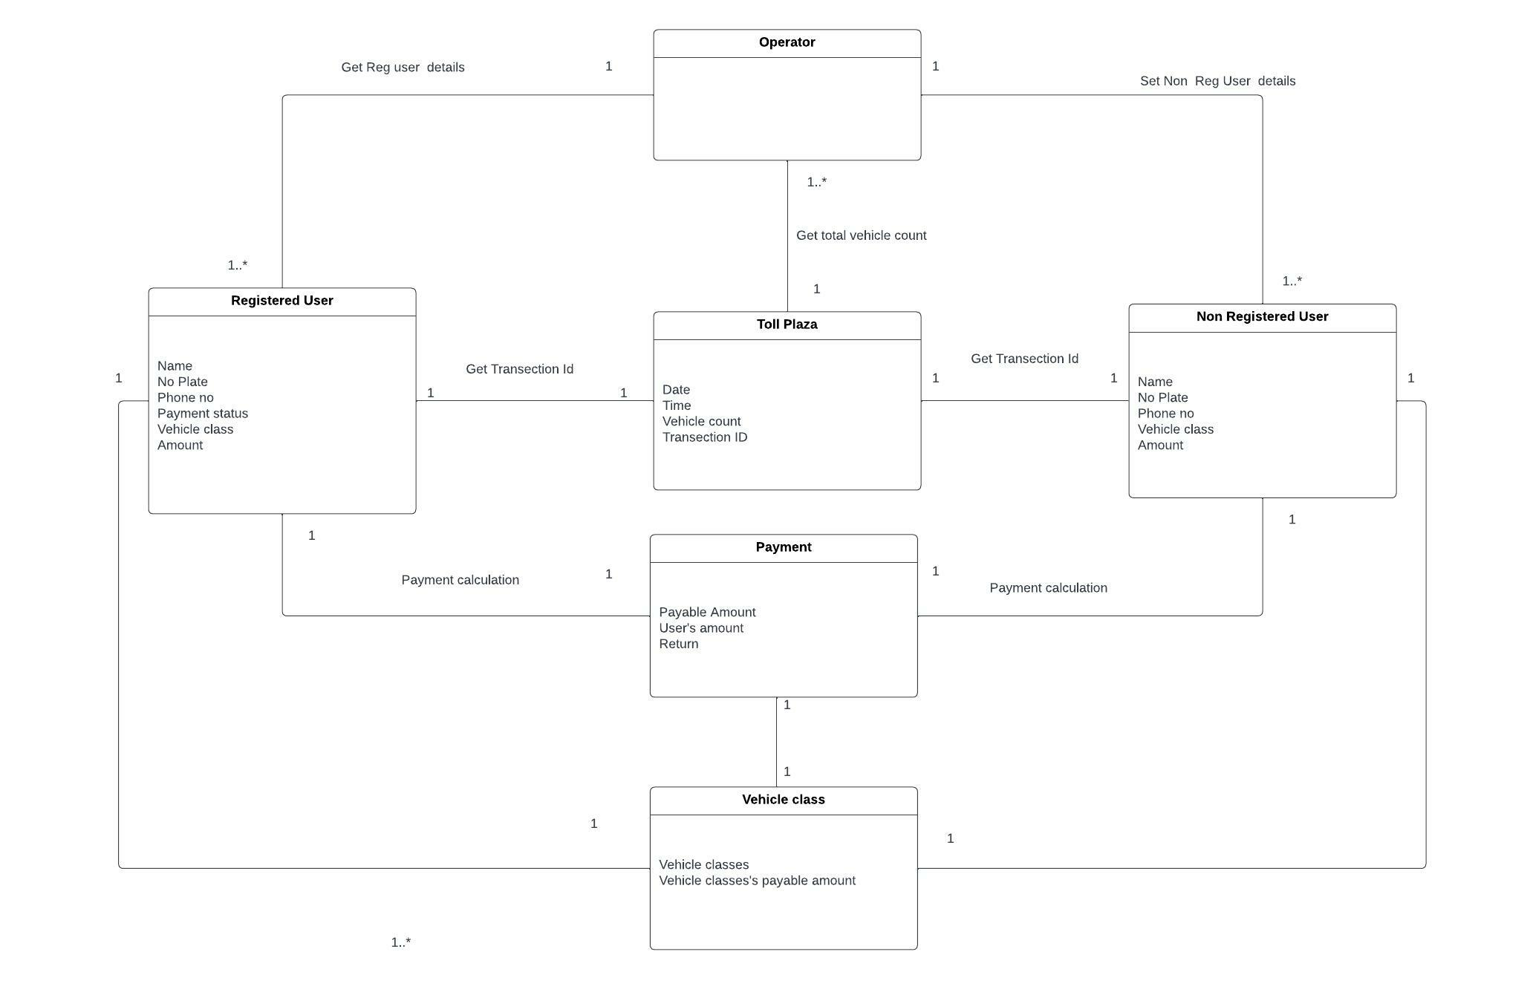
Domain model

Slide 12
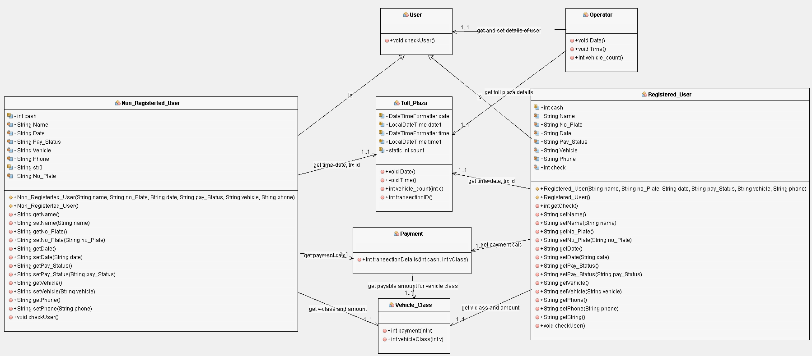
Class diagram

Slide 13
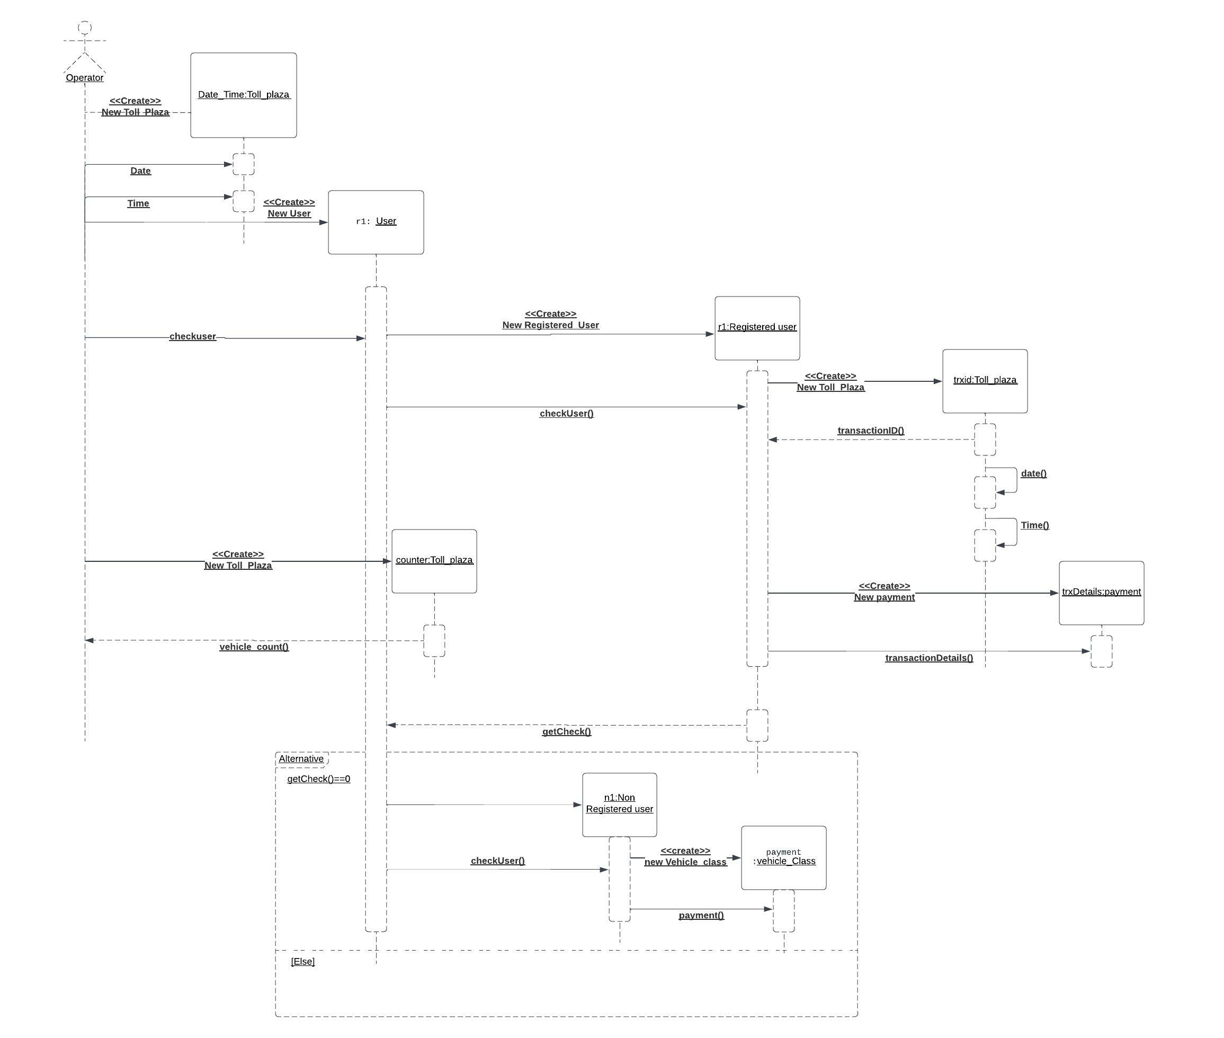
Sequence diagram

Slide 14
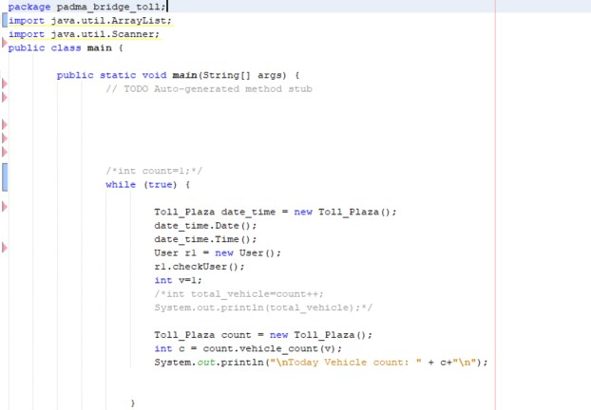
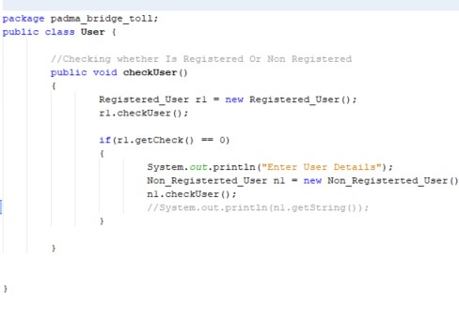
Code snapshots
Main class
User class

Slide 15
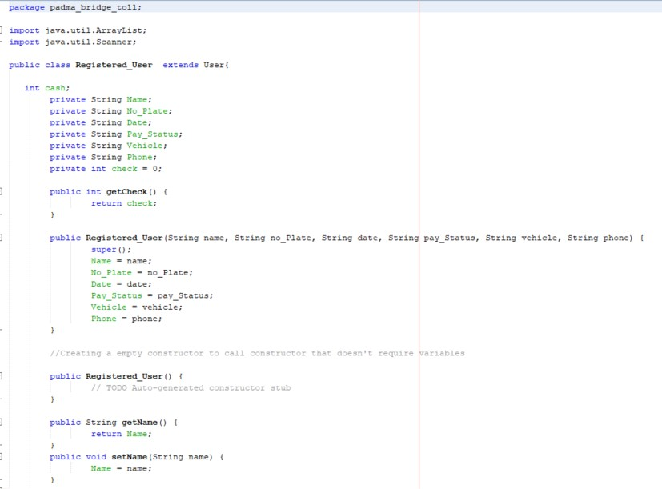
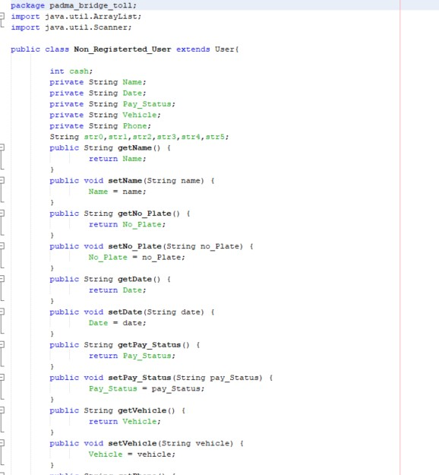
Registered user class
Non Registered user class

Slide 16
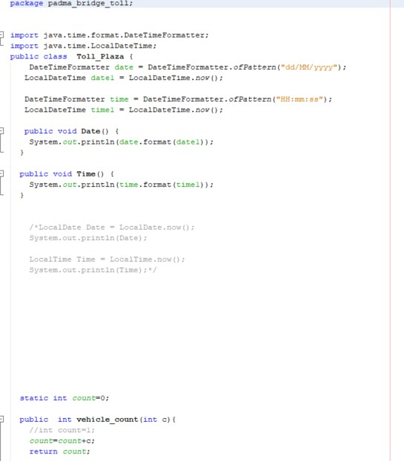
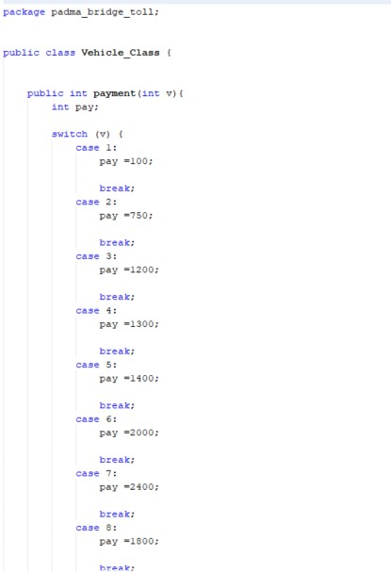
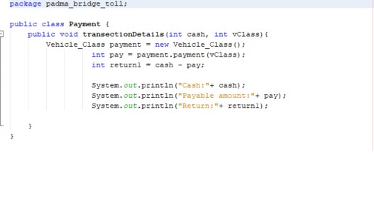
Toll plaza class
vehicle user class
Payment class

Slide 17
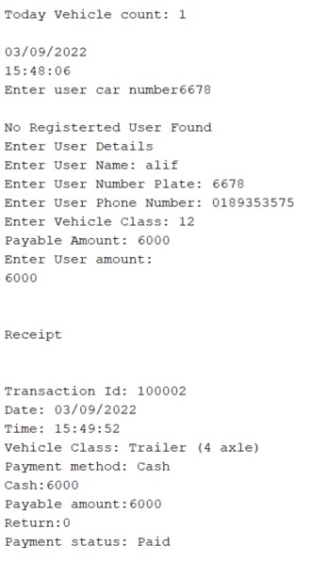
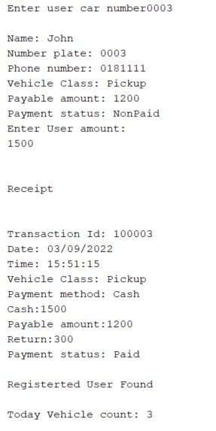
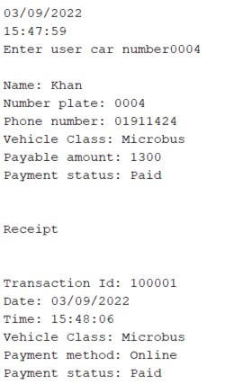
Console:
Paid registered user
unpaid registered user
unpaid non registered user

Slide 18
Conclusion & future work
This system has been made only for the operators while they receiving money and checking payment status. Our future target is to make a mobile application where users can register and pay money using different gateway like internet and mobile banking. We are also planning to make system for the security officers of Padma bridge to handle any problems of the bridge. Furthermore we have plan to make a system where user can get facilities for refreshment during long journey. It will include food management and payment, prayer hall timing etc. We are planning to develop these whole systems in decent manner which would be user friendly, realistic and consistent with the environment.

Slide 19
Github link
https://github.com/ALIF-AL-RAZI/padma-bridge-toll-management

Slide 20
THANKS

